Slide 1
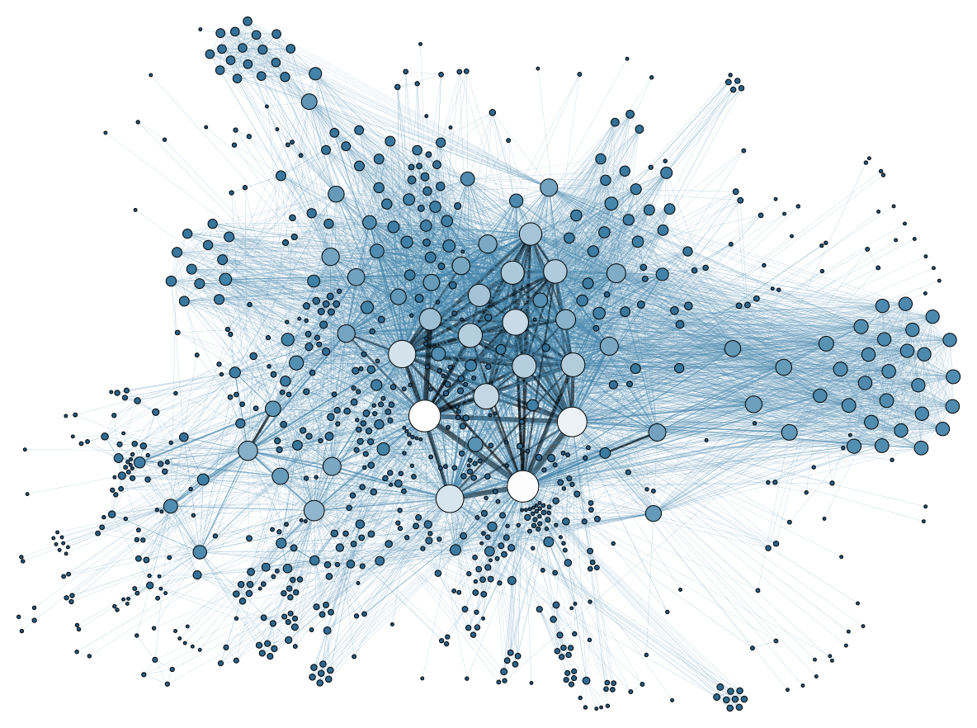
Automobile Data Presentation
Presented by : Akhila
This Photo by Unknown author is licensed under CC BY-SA.

Slide 2

Content
Data Analysis
Visualizations( Graphical representation)
Histogram
Boxplot
Scatterplot
Piechart
Barchart

Slide 3


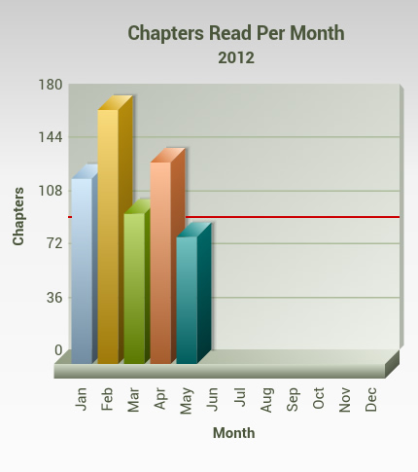

Data Analysis
In the data(automobile data),price is the main crateria
Which one is effect to the price, we will see in the graphical representation
Next slide
This Photo by Unknown author is licensed under CC BY-SA.
This Photo by Unknown author is licensed under CC BY-ND.
This Photo by Unknown author is licensed under CC BY-SA.

Slide 4
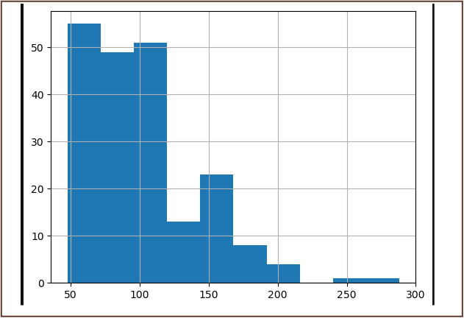
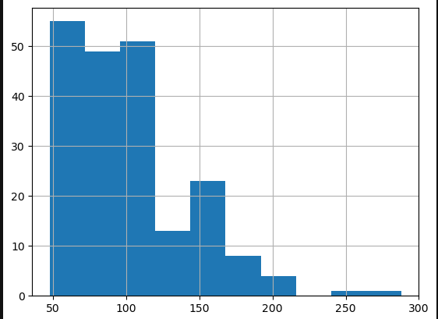
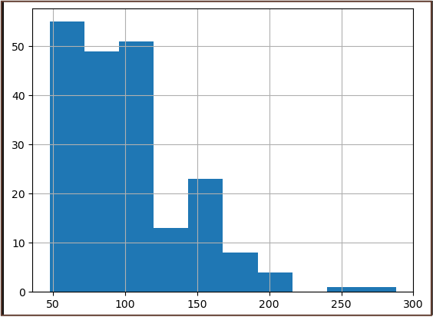
Histogram
In the fig x-axis = horsepower, y-axis = value counts( In histogram y-axis takes value-counts automatically)
In this fig the horsepower range is (48,120) graph is high
In the fig Above 120 range the horsepower graph is low
My prediction is, if the range of horsepower is high,
The price is increased but sales will be low

Slide 5
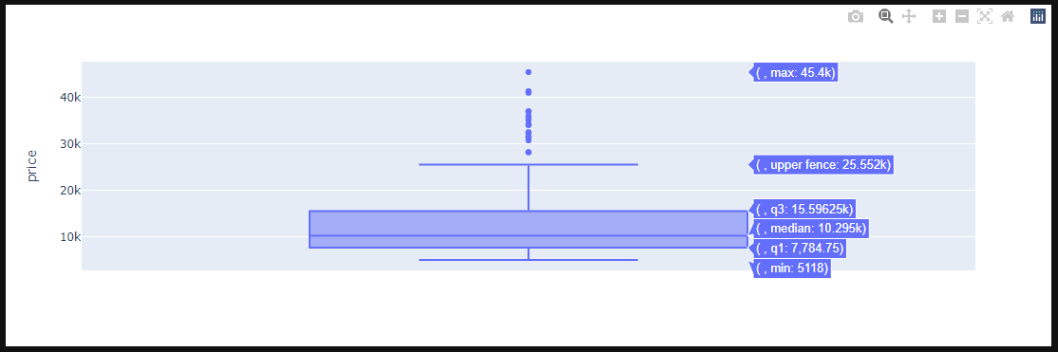
Boxplot
In this fig y-axis='price', (Boxplot takes only y –axis)
In this fig we have three quartiles (q1,q2,q3)
First horizontal line represents min value (price)- 5118k
The box first horizontal line represents q1( 25th percentile)-7,784.75k
The box middle line or second horizontal line represents q2 or median ( 50th percentile ) -10295k
The box third horizontal line represents q3( 75th percentile)- 15.59625k
The second horizontal line represents upper fence value – 25.552k
The dots we can call outliers of the data
Dots represents 0.05% of the price data
My prediction is automobile price 7k to 16k range of cars are high amount of sales
Below 7k and above 16k cars are less amount of sales.

Slide 6
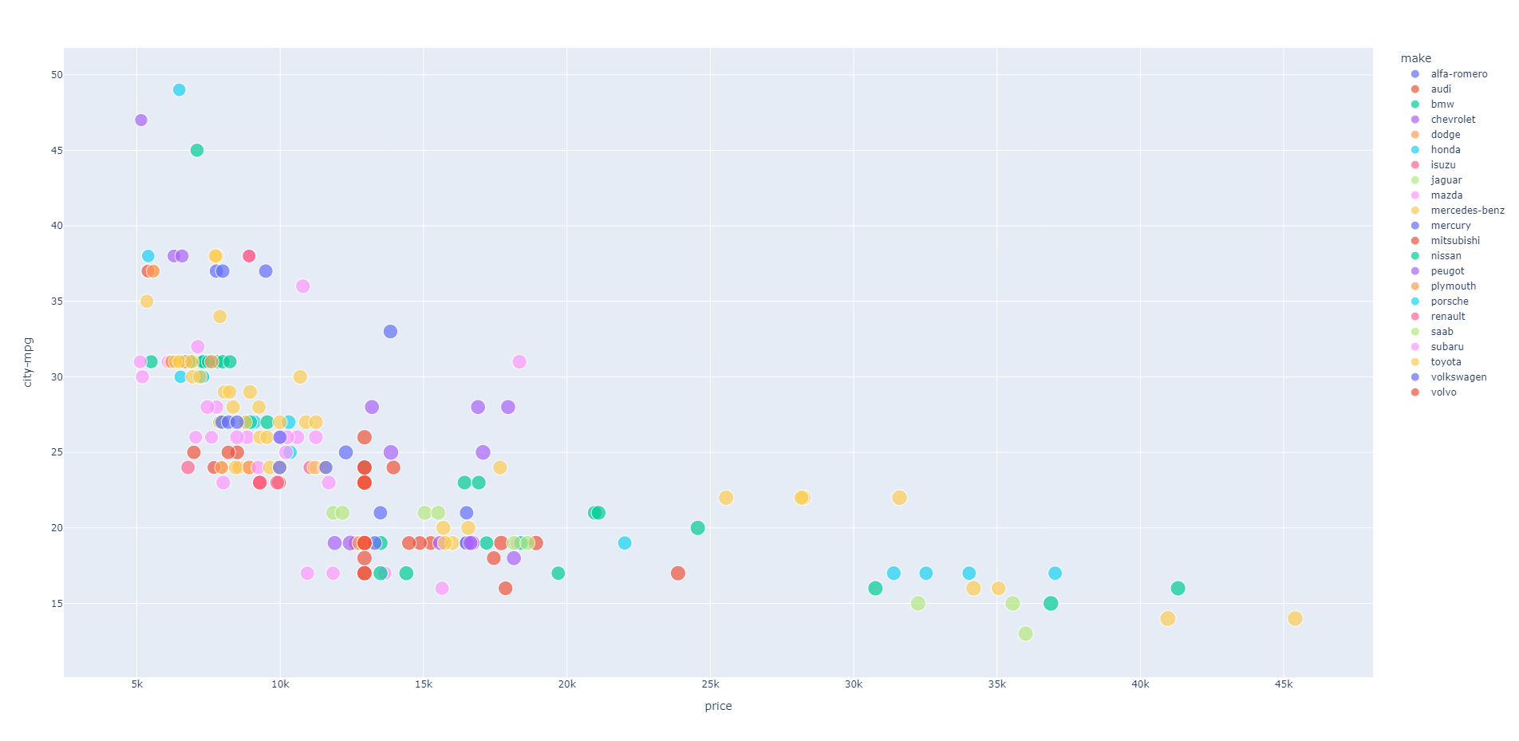
Scatterplot

Slide 7
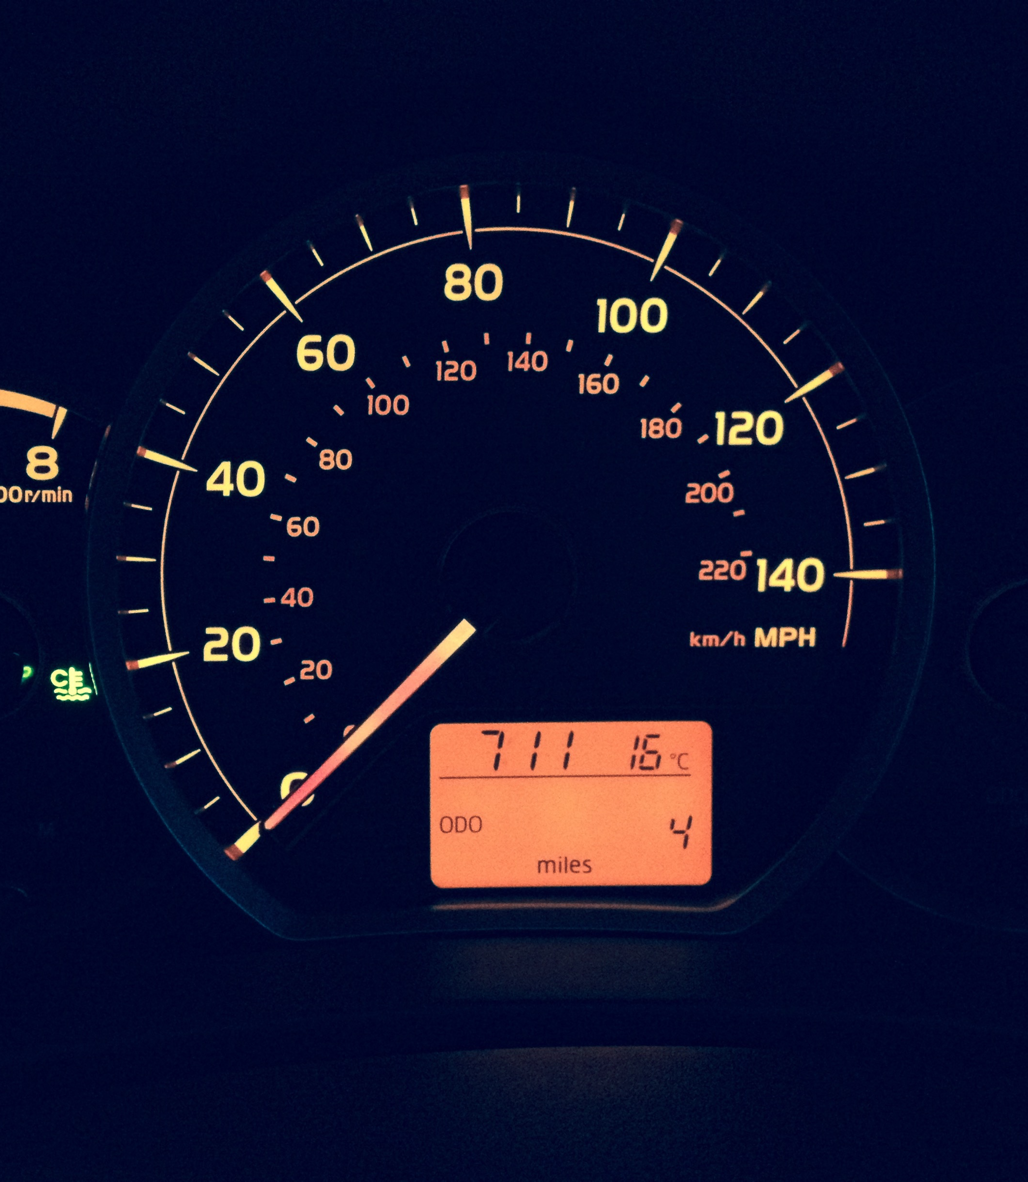
Scatter plot
In the fig represents x-axis='price' , y-axis='city-mpg' , color ='make' , size= 'length', hover_data='width'
The price range - 5k to 10k :,35 to 50 range of city-mpg are high level,less amount of cars sales
: 23 to 34 range of city- mpg are medium level , high amlount of cars sales
The price range – 10kto 15k : 17 to 36 range of city- mpg are medium level of the car sales
The price range – 15kto 20k : 16 to 31 range city- mpg are medium level of the car sales
The price range – 20kto 35k : 15to 22 range of city- mpg are medium Level of the car sales
The price range – 35kto 45.4k : 13 to 17range of city- mpg are low level of the car sales
My prediction is lowest price of cars city-mpg is high, highest price of cars city-mpg is low.

Slide 8
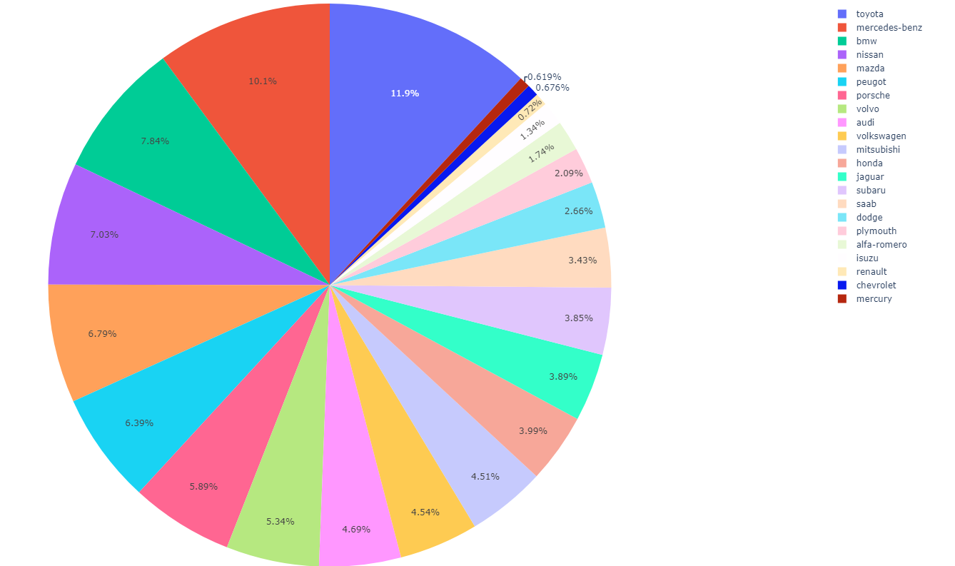
Piechart
In this fig represents values = " price", names ="make"
In the fig 1st place 11.9% toyota car sales are high
2ndplace 10.9% mercedes-benz
3rd places are 7.9% bmw
Last place 2 places are 1. mercury,(0.619%)2.chevrolet(0.676%)
My Prediction is , in this data ,toyota,mercedes-benz,,bmw, nissan,mazda having more sales

Slide 9
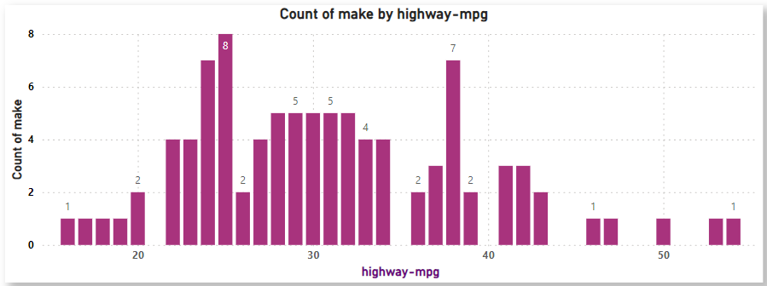
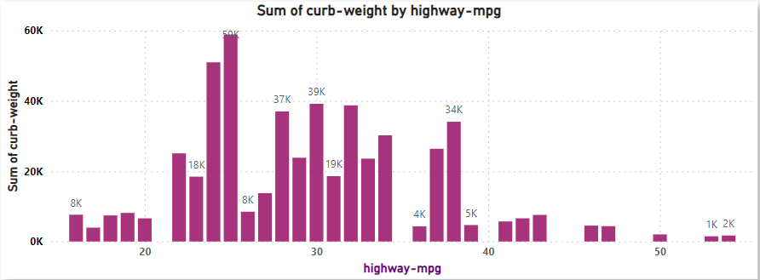
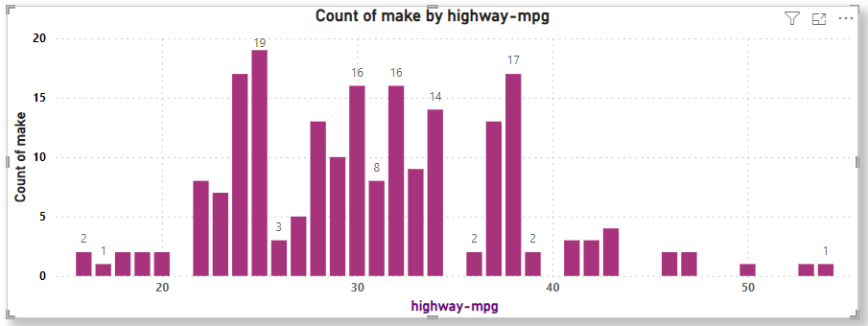
Barplot
Make | count
alfa-romero | 3
audi | 7
bmw | 8
chevrolet | 3
dodge | 9
honda | 13
isuzu | 4
jaguar | 3
mazda | 17
mercedes-benz | 8
mercury | 1
mitsubishi | 13
nissan | 18
peugot | 11
plymouth | 7
porsche | 5
renault | 2
saab | 6
subaru | 12
toyota | 32
volkswagen | 12
volvo | 11
In the fig x-axis= "highway" , y-axis="make".
In the figi highway-mpg range 0 to 20 -: very less amount of cars
In the fig highway -mpg range 20 to 40 -: some of them are medium and some of them are high amount of cars
High amount of cars in range 20 to 40 is toyota,nissan,mazda,honda, mitsubishi
In the fig highway-mpg range 40 to 54 -: range of cars are very low
Least amount of car is renult
My prediction is toyota and nissan cars having high highway-mpg.

Slide 10

Conclusion
In the automobile data I observed that
The highest, lowest price of cars sales are very low
The medium range of car sales are more high when compared to highest and lowest
The highway-mpg 20 to 40 range of cars are having high sales
The city-mpg 23 to 34 range of cars are having high sales
If the range of horsepower is high ,price is also increased but if the price increased amount of sales will be low
Almost customers wants medium price of cars because in our country most of MCP(middle class people) Population
Manufacturer companys to think of MC People And manufactures reasonable price of cars.
Thank you
Presented by
Akhila
( Laerning data analytics @bepec)

